Slide 1

Companion
Application
Leonardo Craven (Team Manager), Gavin Murdock (Developer), Brock Sponenburgh (The Database Dude), Andrew Ward (The UI Guy)

Slide 2
Major design decisions
Website designed for convenience
Players can play tournaments and order drinks at the same time
Staff have a common interface for managing the business
Function over form
Team members new or returning to Django with only some experience
Only 1 team member (Andrew) confident with front-end
Prioritizing just barely good enough
Website should be visually appealing
Mobile-friendly design
Navigation sidebar for simpler navigation
Pictures and logo featured on main pages
Bright, contrasting color scheme

Slide 3
How we used Agile development techniques
Frequent communication
Disclosing absences
Hard deadlines
Assisting each other when able
Feedback from customer
Incremental development
Focused development sprints (models, tournaments, drinks)
Increased efficiency, quality
Easier to assist others
Focus on quality
Cutting requirements if not necessary
Tasks assigned to those with confidence
Focus on visual improvements after customer feedback

Slide 4
Why we are ready for deployment
All requirements in documentation fulfilled
Functionality verified through integration testing in development
System testing procedure created for customer to verify functionality themselves
Remaining tasks:
Finalize visual improvements
Reactivate user type restrictions for webpage access
Fix any bugs found in system testing

Slide 5
Requirement: Users must be able to order drinks from the bar using the app
This requirement is designated as a must have functional requirement. It is listed as requirement 2d in our requirements document.
Sub-requirements:
There must be a menu of available drinks (with prices) for users to order from.
The users must be able to specify how many of each drink they wish to order.
Managers must be able to add or delete drinks on the menu.
After a drink order is placed, it must be sent to a list of current orders only viewable by managers and bartenders.
An order on the list must contain the drinks ordered, the total price, the user’s name, and the user’s current hole number.
Managers and bartenders must be able to mark an order on the list as complete.
Users should be able to cancel a drink order they placed before it is completed.
When a drink order is completed, the user will receive a notification telling them their drink is ready for pick up or is being delivered to their hole (if they are currently playing in a tournament).

Slide 6
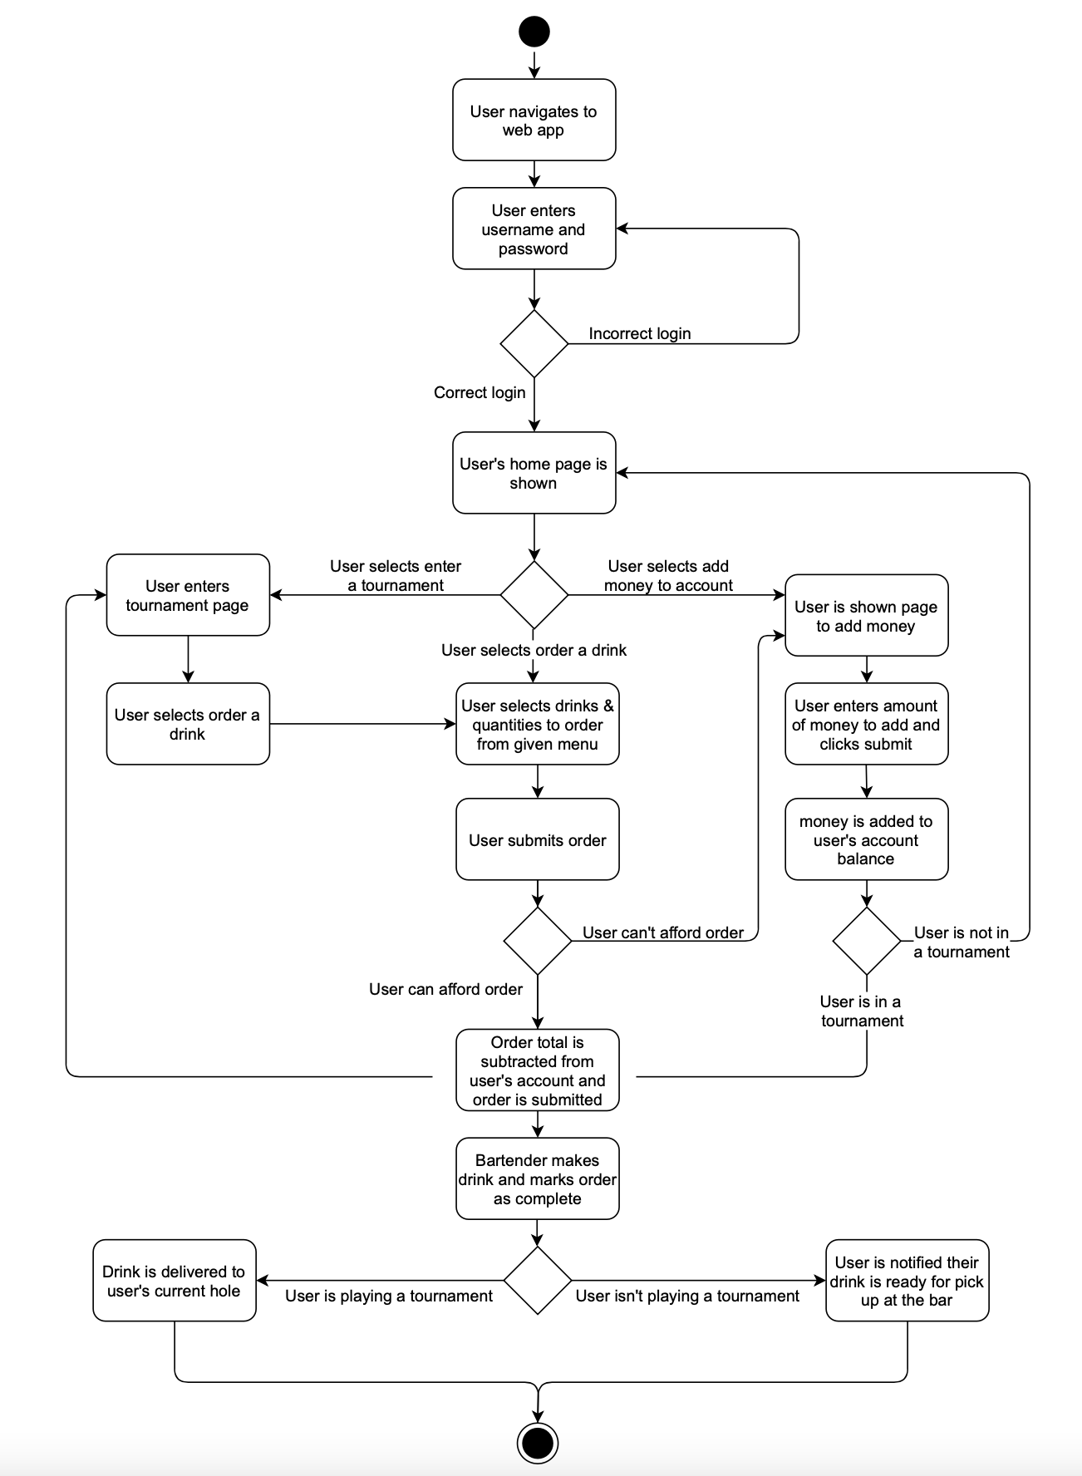
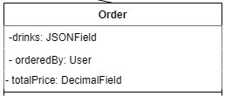
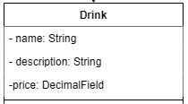
Relevant diagrams for ordering drinks:
UML class diagrams:
Activity diagram:

Slide 7
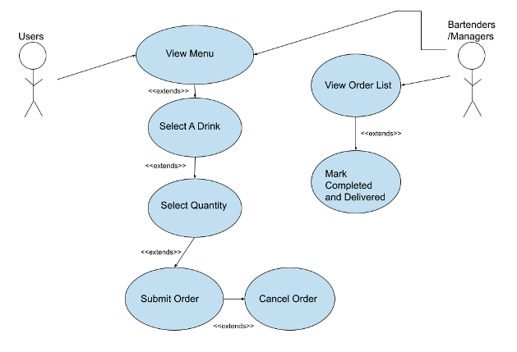
Participating Actors:
Any User for ordering
Bartenders and managers for completing orders
Entry Conditions:
User wants to order drinks
Exit Conditions:
Drinks are ordered
Drinks have been made
Event Flow:
The user views the menu to decide what to order
The user selects certain drinks they wish to order
The user selects quantity of drinks they wish to order
The user submits the order
Before the bartender has marked the order as completed, the user can cancel the order.
Bartender/manager views the list of orders
Bartender makes order
Bartender marks order as complete
User receives notification their order is ready for pickup or is being delivered
Use case diagram:

Slide 8
Scrum tasks associated with ordering drinks and who completed them:
Create drink and drink order models in django
Completed by Leonardo & Gavin
Create a django migration to populate menu with drinks
Completed by Gavin
Create a page for users to view menu and submit a drink order
Completed by Gavin
Create a page for bartenders/managers to access current list of drink orders
Completed by Gavin
Create a page for users to view their current drink orders
Completed by Gavin
Create a page for managers to edit drink menu
Completed by Leonardo
Implement a drink order notification system
Completed by Leonardo

Slide 9
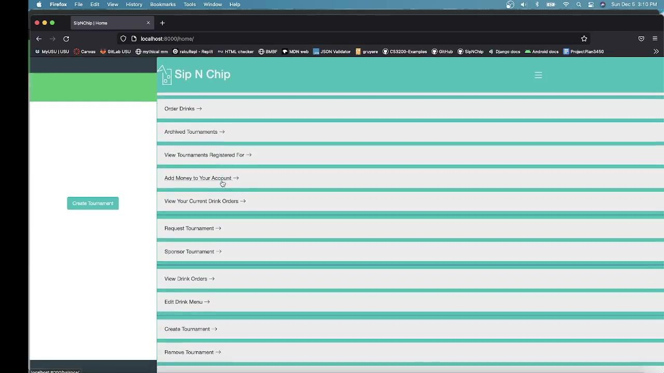
Screen capture video of ordering drinks:

Slide 10
Requirement: The app must support several different user types.
This requirement is designated as a must have functional requirement. It is listed as requirement 2a in our requirements document.
Sub-requirements:
Managers must be capable of setting roles for each user, creating tournaments, approving requests from sponsors for tournaments, and editing the drink menu.
Sponsors must be able to spend money from their account balance to sponsor an already existing tournament or submit a request for a tournament.
Bartenders can view the list of current orders made by users for drinks and manage the list as drinks are completed.
Players can sign up for tournaments, keep track of their score during tournaments, submit a score to the leaderboard after they finish the tournament, and order drinks from the bar using the app.

Slide 11
Requirement: The app must support accounts for each user where they can deposit money to be spent at the putt putt course.
This requirement is designated as a must have functional requirement. It is listed as requirement 2b in our requirements document.
Sub-requirements:
Each account must have authentication with a username and password when logging in.
Users must be able to add any amount of money to their account.
If a user attempts to spend money from their account but does not have enough money for that purchase, the user must be notified that the purchase could not be completed.
When users make purchases at the putt putt course, they must use their account balance as payment.
There must be a separate account unaffiliated with any single user belonging to the putt putt course company itself.
All managers must have access to the company account balance.
All purchases made by users must be paid to the company account balance.
All refunds for drink purchases must be paid from the company account balance.
The account must store the user type.

Slide 12


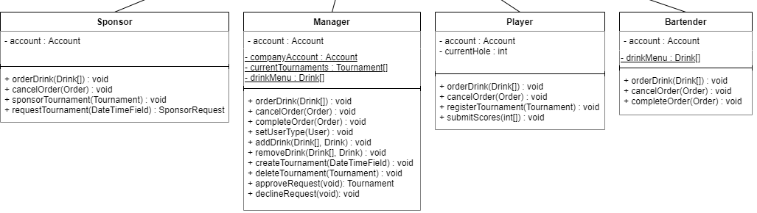
Relevant diagrams for different User Types:
UML class diagrams:
- userType: int

Slide 13
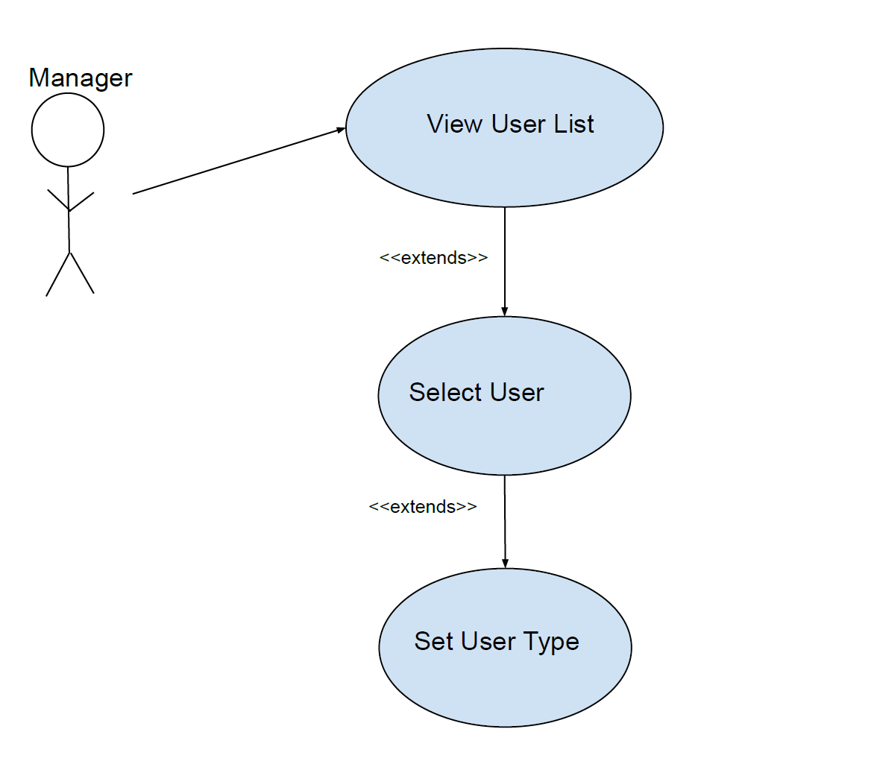
Use case diagram:
Participating Actors:
Managers
Entry Conditions:
Manager wants to edit the user type of another user
Exit Conditions:
User Type has been set for another user
Event Flow:
The manager views a list of all users registered for the app
The manager selects on the dropdown menu what the user’s user type should be set to
The manager clicks the ‘Set Type’ button

Slide 14
Scrum tasks associated with ordering User Types and who completed them:
Create user and account models
Completed by Leonardo & Brock
Create a django migration to populate database with a company account
Completed by Brock
Create a page for managers to set user types of all users
Completed by Brock
Implement Dynamic Home Page based on User Type
Completed by Andrew
Add User Type support to existing pages
Completed by Brock
Add a company account for managers
Completed by Brock
Implement add money to account page
Completed by Brock
Implement a page for sponsors to request a tournament
Completed by Leonardo
Implement a page for sponsors to sponsor an existing tournament
Completed by Andrew
Implement a page for managers to approve or deny sponsor tournament requests
Completed by Gavin

Slide 15


Slide 16
Requirement: Users must be able to record scores and view a leaderboard
This requirement is designated as a must have functional requirement. It is listed as requirement 2c in our requirements document.
Sub-requirements:
Tournaments must be 18 holes in length.
Players must be able to sign up for tournaments the day they are held.
Players must only be able to sign up for any particular tournament once.
Players should be able to view which tournaments they signed up for that day.
As players play through the tournament, they must be able to keep track of their scores for each hole using the app.
Once players finish the tournament, their scores must be sent to a leaderboard that is publicly viewable by all players in that tournament.
Players must submit their scores to the leaderboard once they complete the tournament.
Players must not be able to submit their scores if one or more holes do not have a score entered.
When a tournament is finished, the top 3 finishers in the tournament should receive a cash prize credited to their user account.
1st place should receive $100, 2nd place should receive $50, and 3rd place should receive $25.
Managers must be the only users who can create or cancel tournaments.
After a tournament is finished, the tournament should be archived for historical purposes.
The tournament must be archived the day after it finishes.
Managers must be able to view the entire list of archived tournaments.
Players must be able to view a list of archived tournaments they participated in.
The tournament must be able to handle multiple players playing on the course at the same time.
As players move through the course inputting their score for each hole, their hole location must be automatically updated.
Tournaments must be able to be sponsored by a sponsor.
Sponsors must be able to choose a specific tournament to sponsor.
Sponsors must be able to request a tournament to be held on a specific date.
Managers must be able to approve requests from a sponsor to hold a tournament.
When a sponsor sponsors a tournament or submits a request for a tournament, $500 must be deducted from the sponsor’s account balance and added to the company account balance.

Slide 17
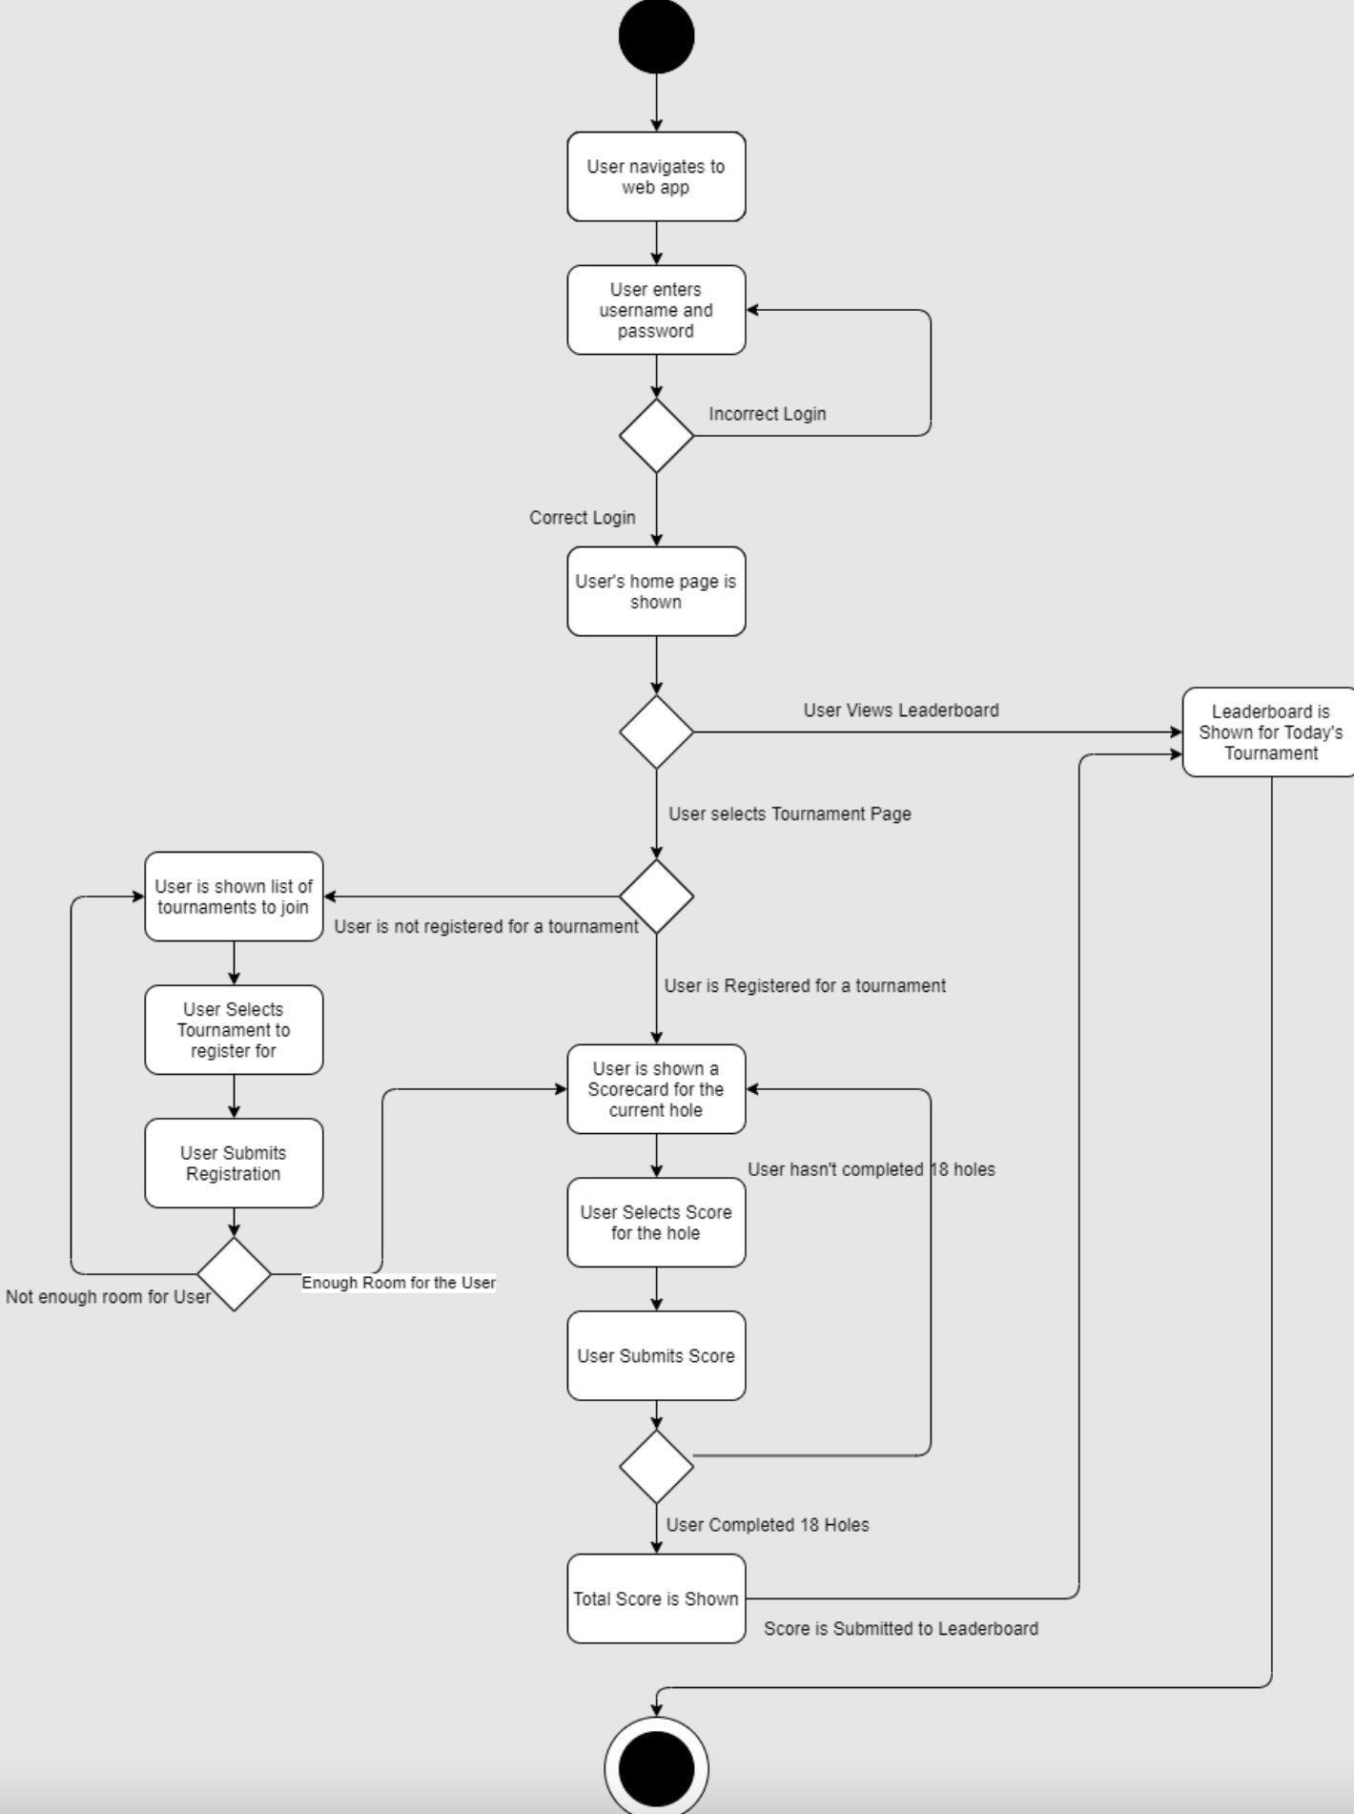
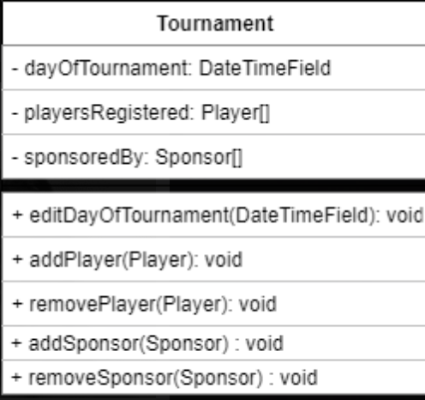
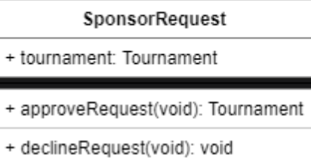
Relevant diagrams for tournaments:
UML class diagrams:
Activity diagram:

Slide 18
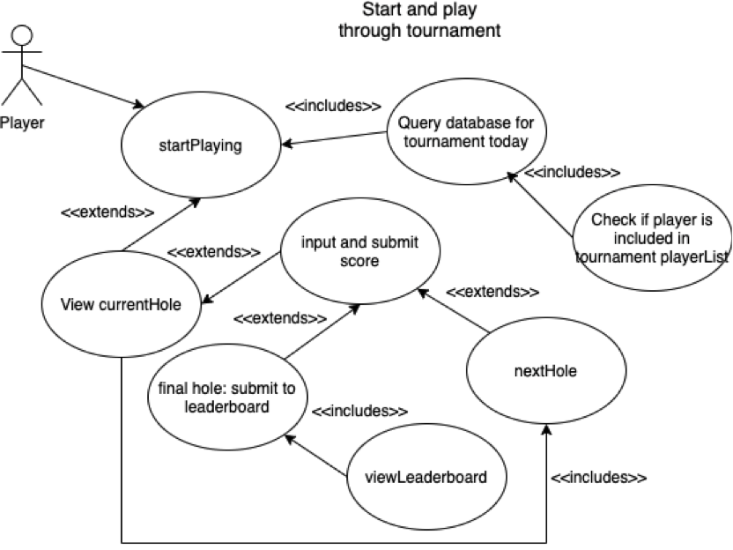
Use case diagram:
Participating actor(s): Player
Entry Conditions:
User is logged in as Player
Player wants to start playing right away
Exit Conditions:
No tournament is today
Player is not registered for tournament today
Player finishes tournament/playing
Event Flow:
Player navigates to startPlaying
If no tournament is today or player is not registered for tournament, then corresponding message is displayed
Player views current hole
Player submits score and system goes to next hole
System reaches final hole and player’s score and other data is added to leaderboard
Player is redirected to leaderboard

Slide 19
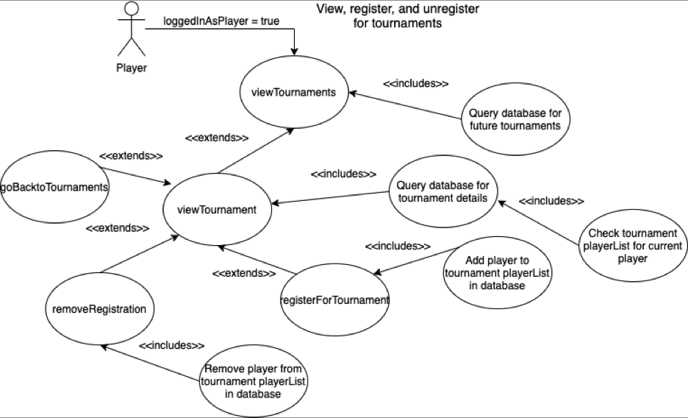
Use case diagram:
Participating actor(s): Player
Entry Conditions:
User is logged in as Player
Player wants to view tournaments and/or register/unregister for tournaments.
Exit Conditions:
Player stops looking at tournaments or tournament
Customer registers for tournament
Customer unregisters for tournament
Event Flow:
Player is logged in.
Player views current tournaments.
Player selects a specific tournament.
Player can return to tournaments view.
Player register for tournament (if not already registered) OR
Player unregisters for tournament.
System returns to list of tournaments view.

Slide 20
Scrum tasks associated with creating, playing, a tournament & viewing leaderboard:
Implement page for users to track scores
Completed by Gavin
Implement tournament sign-up page
Completed by Leonardo
Implement scorecard page
Completed by Leonardo
Implement leaderboard page
Completed by Leonardo
Implement archive page of past tournaments
Completed by Gavin
Implement page for users to view tournaments they're currently signed up for
Completed by Gavin
Implement user notification system for tournament flow
Completed by Leonardo
Implement page for managers to create tournaments
Completed by Leonardo

Slide 22
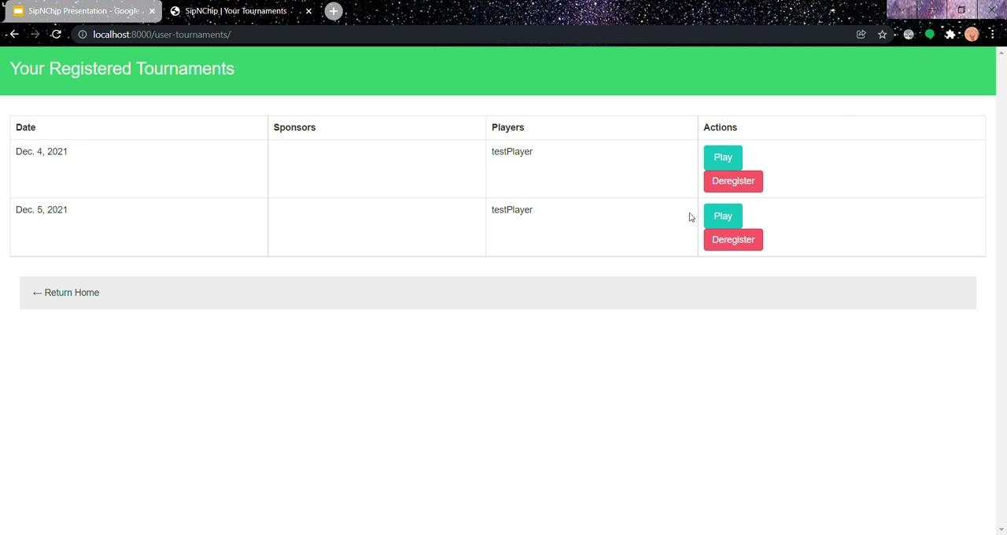

Slide 23
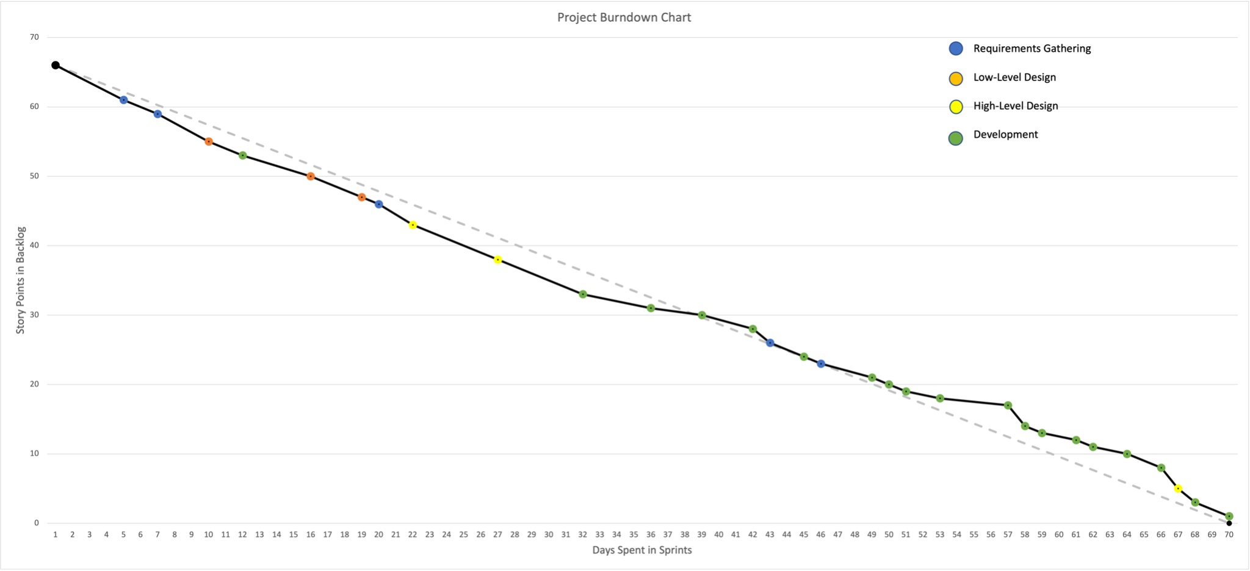
Four Color Burn-down Chart:
(Only four colors because we didn’t have any tasks associated with testing, we just did integration testing after each development task)

Slide 24
Resources
Amr M. AbdulRahman, Kqw, Keithhackbarth, & sirFunkenstine. (2012, April 29). How to create a user in Django? Stack Overflow. Retrieved December 2, 2021, from https://stackoverflow.com/questions/10372877/how-to-create-a-user-in-django
Django documentation | Django documentation | Django. (n.d.). Django. Retrieved December 2, 2021, from https://docs.djangoproject.com/en/3.2/
Freitas, V. (2017, March 24). How to Extend Django User Model. Simple Is Better Than Complex. Retrieved December 2, 2021, from https://simpleisbetterthancomplex.com/tutorial/2016/07/22/how-to-extend-django-user-model.html
Ivy, D. [Dennis Ivy]. (2020, January 3). User Registration and Login Authentication | Django (3.0) Crash Course Tutorials (pt 14) [Video]. YouTube. https://www.youtube.com/watch?v=tUqUdu0Sjyc
Otto, M. J. T. (n.d.). CSS · Bootstrap. Bootstrap. Retrieved December 2, 2021, from https://getbootstrap.com/docs/3.4/css/

Slide 25
Questions?

